Slide 1
ChapterS 6&7: Homeostasis of body temperature and body fluids
UNIT 3

Slide 2
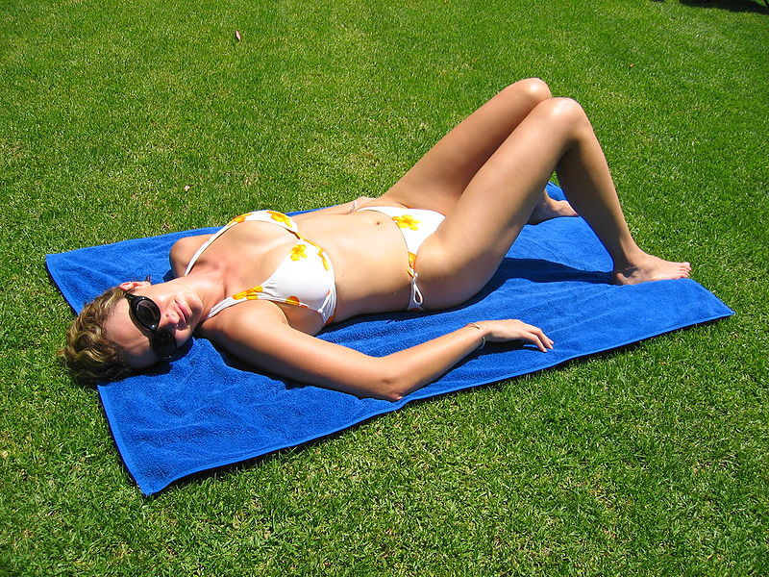
Radiation
There is no direct contact with source e.g. sun or a fire.
Radiation can result in heat gain or heat loss.

Slide 3
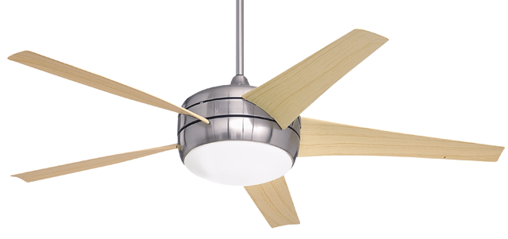
Convection
Occurs when hot or cold air passes over a body.
For example, using a fan or fan heater.
Convection results in heat gain or heat loss.

Slide 4
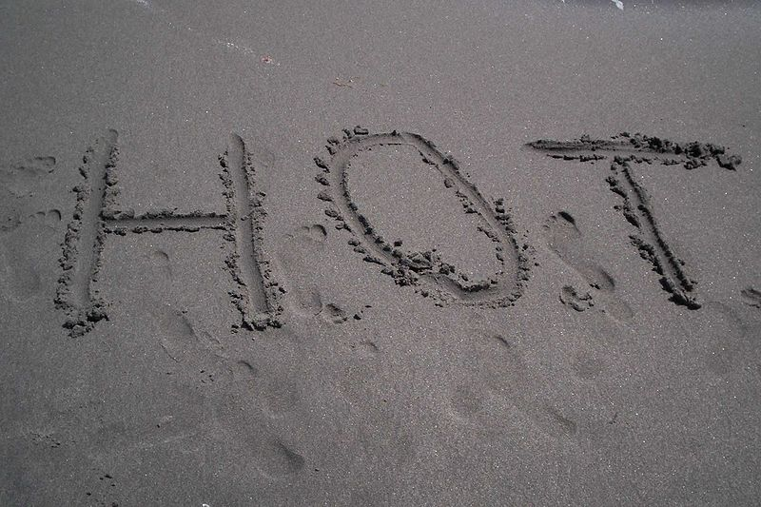
Conduction
Occurs from direct contact with heat source e.g. standing on hot sand with bare feet.
Results in heat gain or heat loss.

Slide 5
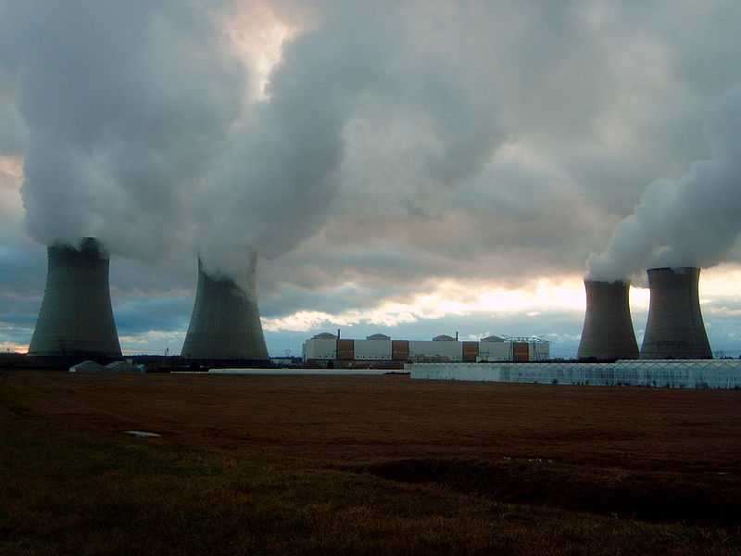
Evaporation
Evaporation is the transformation of water from its liquid state to its gaseous state (i.e. steam or water vapour).
The evaporation of sweat results in heat loss only.

Slide 6
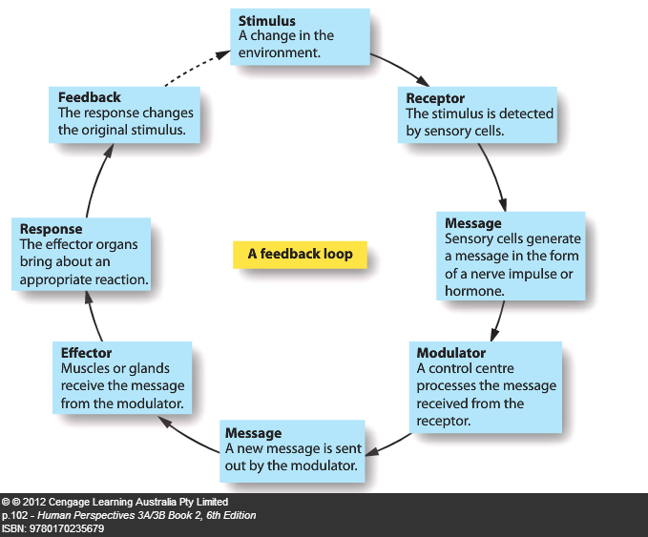
Stimulus-response feedback
This is a model used to explain how homeostatic mechanisms work. For example:

Slide 7
Negative feedback (steady state)
Hormonal secretions are controlled by the NEGATIVE FEEDBACK homeostatic mechanism.
Negative feedback occurs when the response is opposite to the initial stimulus.

Slide 8
homeostasis
the maintenance of a constant internal environment in the presence of a changing external environment.
E.g. Body temperature and blood glucose levels fluctuate around a normal level (the set point) . This fluctuation is called dynamic equilibrium.
Homeostasis ensure that:
a) the optimal temperature remains relatively constant at 37 degrees.
b) substances dissolved in body fluids remain at optimal concentrations
c) the volume of fluids are kept relatively constant so that pressure
gradients remain optimal.

Slide 9
Steady state
The following conditions need to be kept in a relatively steady, homeostatic state:
a) oxygen levels
b) temperature
c) carbon dioxide levels
d) water levels
e) blood glucose (sugar) levels
f) pH levels
g) urea levels
h) ion concentrations

Slide 10
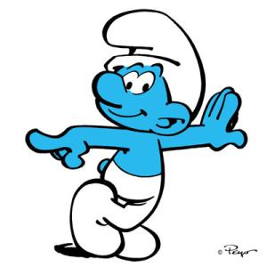
Negative feedback loop- srmerf
Stimulus- a change in the environment alerts the the body to take action.
Receptor- detects the change in the internal and/ or external environment
Modulator- regulates the information from the receptor and directs the actions of the effector.
Effector- a structure that carries out a response to counteract the initial stimulus
Response-what the effector does
Feedback- modifies the original stimulus in order to achieve a steady state. It is opposite (negative) to the stimulus.

Slide 11
A Negative Feedback Loop – a diagram explaining negative feedback
Stimulus
Causes an internal change
Feedback
New information – opposite to the stimulus
Receptor
Detects the change
Response
The compensation process
Modulator
Decides what needs to be done to counter the change
Effector
Performs the compensation process

Slide 12
Negative feedback
In homeostatic mechanisms the response has the effect of reducing or eliminating the stimulus that caused it. This is called negative feedback.
For example if you have the stimulus of a cold environment. The thermoreceptors in the skin detect this and a message is sent to the modulator; the hypothalamus. A message is sent to the effector, your skeletal muscles. The response is shivering, which raises the body temperature. The increase in body temperature is opposite to the original stimulus.
http://health.howstuffworks.com/adam-200092.htm

Slide 13
Positive feedback
When positive feedback occurs, the response to a stimulus reinforces and intensifies the stimulus.
The best example of positive feedback is during childbirth. Oxytocin is secreted from the pituitary to cause contractions of the uterus. This results in the baby’s head pushing on the mother’s cervix. This stimulation of the cervix causes more oxytocin to be secreted, which further intensifies the contractions.

Slide 14
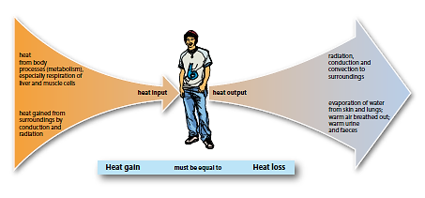
Thermoregulation
The balance between heat production and heat loss is called thermoregulation.

Slide 15
Heat production
During the process of cellular respiration energy is released in the cell; most of this energy is released in the form of heat.
Energy used for active transport, muscle contraction, building complex molecules
The rate at which energy is released by the breakdown of food is called the metabolic rate.
Exercise will increase metabolic rate (and therefore heat production) by up to 40x times due the muscular activity.
Stress will increase metabolic rate due to the stimulation of the autonomic sympathetic nerves which release noradrenaline. Noradrenaline increases the metabolic activity of cells.
During a fever, the metabolic might double the normal rate. For each 1 degree Celcius rise in temp, rate of biochemical reactions increase by about 10%.

Slide 16
An increase in body temperature also increases metabolic activity. For each 1ºC rise in body temperature that occurs the metabolic rate increases about 10%.
An increase in body temperature is usually associated with fever.
Under most conditions body temp is higher than surrounding environmental temp.
Increase in body temp can cause nerve malfunction, change in structure of proteins and therefore enzymes denature and consequent death.

Slide 17
Temperature receptors
Temperature receptors are called thermoreceptors. If they are found in the skin or mucous membranes, they are called peripheral thermoreceptors. If they are found in the hypothalamus, spinal cord or abdomen, they are called central thermoreceptors.
Peripheral thermoreceptors give information about the external environment. They can be cold receptors (which are stimulated by low environmental temperatures) or heat receptors (which are stimulated by high environmental temperatures).
Central thermoreceptors detect changes to the core body temperature.
The hypothalamus receives information from both peripheral and central thermoreceptors and regulates the body’s temperature using this information.

Slide 18
The role of the skin in temperature regulation
Heat is lost from the body by conduction, convection, radiation and evaporation.
The skin can change the rate at which heat is lost from the body. This is partly due to the blood vessels which lie under the skin that carry blood, and therefore heat from the core of the body.
The autonomic nervous system can change the diameter of these blood vessels. If the blood vessels dilate it is known as vasodilation. If they constrict it is known as vasoconstriction. (Sympathetic nervous system)
When vasodilation of these blood vessels occur more blood flows to the surface, carrying more heat to the surface. (Parasympathetic nervous system)

Slide 19
When vasoconstriction of these blood vessels occur less blood flows to the surface, carrying less heat to the surface.
The other way that heat can be lost from the skin is through sweating. When we sweat fluid is secreted by the sweat glands into ducts which open onto the surface of the skin. Cells surrounding these ducts pump the sweat onto the skin.
Heat is removed by evaporation of the sweat, as heat (from the skin) is needed for the liquid sweat to become vapour. Water evaporation from the lungs loses heat in a similar fashion.
Sweating is stimulated by the sympathetic nervous system.

Slide 20
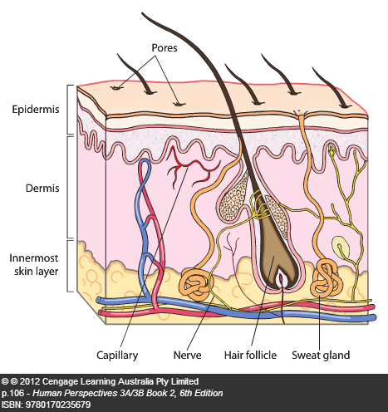

Slide 21
Preventing body temperature from falling
When the environmental temperature falls the cold receptors in the skin send messages to the hypothalamus. The hypothalamus then sends out messages that either reduce heat loss or increase heat production. These may be either physiological or behavioural changes.
Vasoconstriction - Medulla oblongata under influence of hypothalamus regulates the diameter of blood vessels
Sympathetic efferent nerves which stimulate the blood vessels in the skin to constrict. This reduces the flow of blood from the core to the skin, and therefore reduces the transfer of heat from the core to the skin. The skin will feel cooler and less heat will be lost from it.
Pilo-erection: Muscles attached to hair in skin contract , pull hair erect, hair traps air – air is a poor conductor of heat – this is attempt to reduce heat loss.

Slide 22
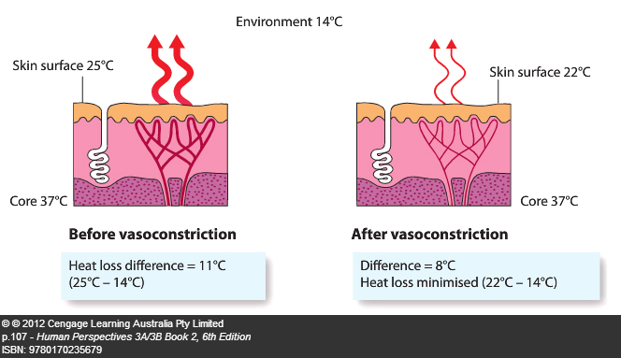

Slide 23
3. Stimulation of adrenal medulla – This also occurs through the sympathetic nerves. It results in the secretion of adrenaline and noradrenaline. Both of these hormones bring about an increase in cellular metabolism and therefore heat production.
4. Shivering – The hypothalamus stimulates the parts of the brain that increase skeletal muscle tone. This leads to oscillating, rhythmic muscle tremors (shivering).

Slide 24
5. Increased thyroxine production – The hypothalamus produce thyroid stimulating releasing factors (TSHrF) which stimulated the anterior pituitary to secrete TSH. This causes the thyroid to release thyroxine which increases metabolic rate, and therefore heat production.
6. Behavioural responses – When we are consciously aware of cold conditions we behave in a way to reduce heat loss, such as putting on a jumper, sheltering from the cold or turning on a heater.

Slide 25
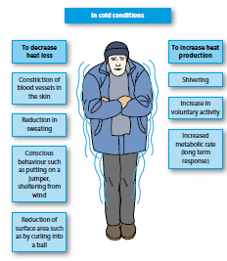

Slide 26
Preventing body temperature from rising
When the environmental temperature rises excess heat needs to be lost from the body otherwise the core temperature will rise. The body may do this through:
Medulla oblongata under influence of hypothalamus regulates the diameter of blood vessels
Vasodilation – Stimulated by parasympathetic nervous system. The blood vessels in the skin dilate, carrying more blood from the core to the surface and therefore more heat.
Heat is lost through radiation and convection.

Slide 27
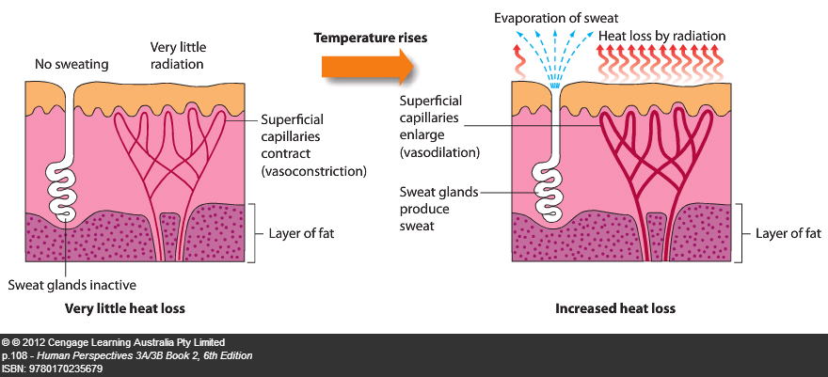
2. Sweating – If the environmental temperature increases above 28ºC . It is only an effective method of heat loss if the environment is dry. If it is humid sweat cannot evaporate, and therefore heat is not lost.

Slide 28
3. Reduced thyroxine production – a reduction in thyroxine is brought about in summer, so that there is a decrease in the metabolic rate and therefore less heat is produced in summer.
4. Behavioural responses - When we are consciously aware of hot conditions we behave in ways to increase heat loss, such as removing extra clothing, turning on fans and air conditioners.

Slide 29
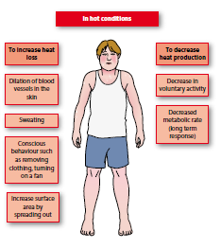

Slide 30
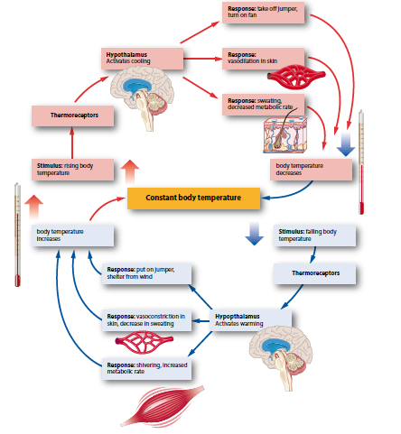
Control of thermoregulation

Slide 31
Temperature tolerance
A core body temperature over 42ºC is dangerous, with death usually occurring if it rises above 44ºC. This high body temperature may occur due to:
Fever .
Heat stroke – This occurs when temperature and humidity are high and it is difficult for the body to lose heat by radiation or evaporation. Body temperature rises and regulatory mechanisms fail. Could be fatal if brain cells are affected.
Treatment: cooling body as quickly as possible to immersing patient in cold water.
Heat exhaustion – This occurs as a result of extreme sweating and vasodilation to lose heat. These reduce the volume of blood plasma and the resistance to blood flow, causing the reduction of blood pressure and and output of blood from heart is reduced. Person collapse. The body temp is nearly normal unlike heat stroke.

Slide 32
If a persons core temperature falls below 33ºC the metabolic rate is so slow that heat production cannot replace the heat lost. This is called hypothermia and it may result in death. Blood becomes viscous (thick) and cannot transport sufficient oxygen to brain – coma – death.

Slide 33
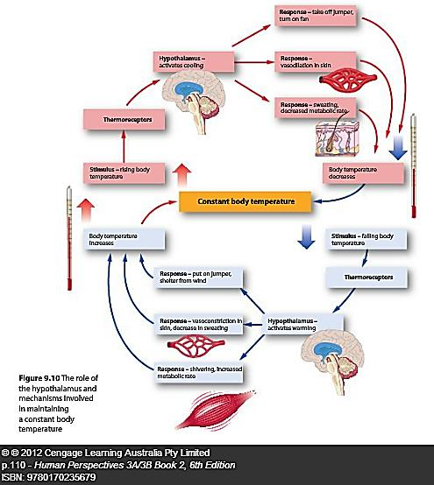

Slide 34
Regulation of the composition of body fluids
The human body is approximately 60% water. The types of fluid found in the body are :
Intracellular fluid 2/3 (cytosol – fluid part of cytoplasm) – this is the fluid found in the cell.
fluid 1/3 – this is the fluid found outside of the body. It is either:
Blood (1/4)
Intercellular fluid (¾ )(interstitial fluid/ tissue fluid) – this is the fluid found between cells.
There is a continuous exchange of materials between the different types of fluid.

Slide 35
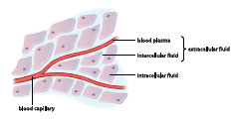

Slide 36
Fluid balance
Fluid gain must equal fluid loss if the composition of body fluids is to be kept fairly constant.
Fluid is gained by taking in liquid of food containing water. A small amount is also gained as a by-product of chemical processes (metabolic water) occurring in the cell.
Fluid is lost from the body through the kidneys, skin, lungs and alimentary canal.
About 2.5L is lost per day.

Slide 37
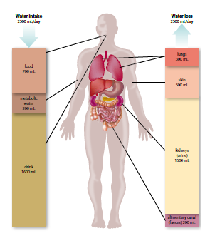

Slide 38
Excretion
Excretion is the removal from the body of the waste products of metabolism. The organs involved in excretion are:
Lungs - excrete carbon dioxide and small amounts of water vapour.
Sweat glands – excrete water which contains salts, urea, and lactic acid.
Alimentary canal – excretes bile pigments (the bulk of faeces is undigested food, and therefore not considered to be excretory products). Faeces excrete old red blood cells but eliminate or egest undigested food.
Kidneys – excrete water and urea and are responsible for maintaining the concentration of materials in the body fluids.

Slide 39
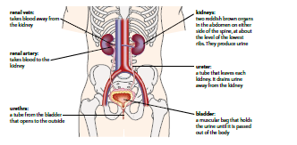
The kidneys

Slide 40
The body cannot regulate water loss from the lungs or alimentary canal. Water loss through sweat is regulated by thermoregulation.
Only water loss through the kidneys regulates the concentration of water and dissolved substances.
The kidneys are a pair of reddish-brown organs located in the abdomen.
The ureter is a tube that leaves each kidney and drains into the urinary bladder. This then empties to the outside of the body through the urethra.
The kidney is made up of about million microscopic units called nephrons.

Slide 41
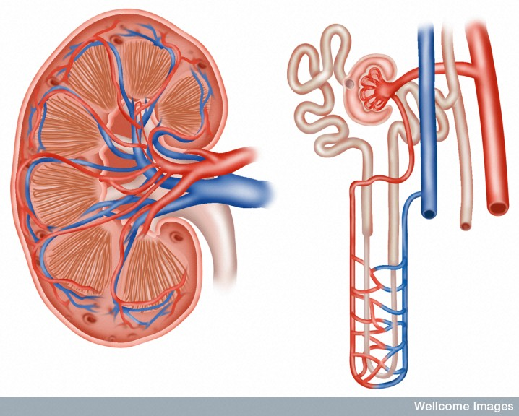
Structure of the kidney
Proximal convolute tubule
Distal convolute tubule
Capsule
Cortex
Renal corpuscle
Medulla
Pyramid
Renal artery
Collecting duct
Renal vein
Loop of Henle
Pelvis of ureter
Peritubular capillaries
Ureter
LS of KIDNEY
A NEPHRON

Slide 42
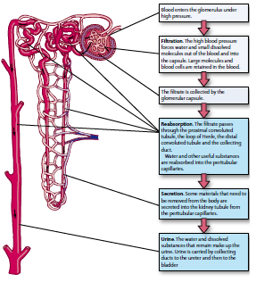

Slide 43
Control of water loss by the kidneys
About 90% of the water filtered through the glomeruli is reabsorbed. The reabsorption occurring along the proximal convoluted tubule and the loop of Henle is by osmosis. The reabsorption along the distal convoluted tubule and collecting duct occurs by active reabsorption, under the control of antidiuretic hormone (ADH).
ADH changes the permeability of the walls in the distal convoluted tubule and the collecting duct.
If the concentration of ADH in the blood plasma is high then the tubules are more permeable to water. This means that more water leaves the tubule and enters the capillaries. This reduces the volume of the fluid in renal tubules and therefore increases the concentration of the dissolved materials.

Slide 44
When the concentration of ADH in the blood plasma is low the tubules are not very permeable to water. Little water is reabsorbed into the blood. This means that the fluid in the tubules is dilute.
The action of ADH is an example of feedback and is outlined below:
If there is a decreased amount of water in the blood, such as would result from increased loss of water through sweat, the water concentration of the blood plasma would decrease. This means that the osmotic pressure of the blood is raised.
2. Osmoreceptors in the hypothalamus detect the increased osmotic pressure of the blood.

Slide 45
3. The hypothalamus stimulates the posterior lobe of the pituitary gland to release ADH into the bloodstream.
4. ADH is carried all over the body by the blood but it affects its target organs which are the nephron tubules in the kidney. The permeability to water of the distal convoluted tubules and the collecting ducts is increased.
5. More water is then reabsorbed into the blood plasma from the tubules and ducts.
6. The reabsorption of water increases the water concentration in the plasma so that the osmotic pressure of the blood is decreased.
7. The response is decreased osmotic pressure of the blood. This has eliminated or reduced the original stimulus that was increasing osmotic pressure of the plasma. Negative feedback has occurred.

Slide 46
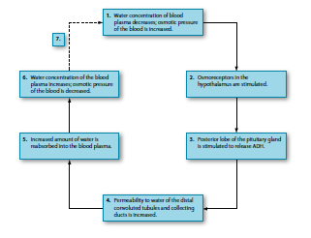

Slide 47
Reabsorption of water under the influence of antidiuretic hormone
Stimulus – blood dehydrated
→ Decreased blood volume → reduced blood pressure → increased osmotic pressure
Receptor Osmoreceptors in hypothalamus
→ activates thirst reflex (physical response)
→ stimulates pituitary gland (homeostatic physiological response)

Slide 48
Transmission
nerve signal to posterior pituitary gland ADH released into bloodstream
Effector
DCT and collecting duct
Response
Increases permeability of above structures water (approx 10%) reabsorbed

Slide 49
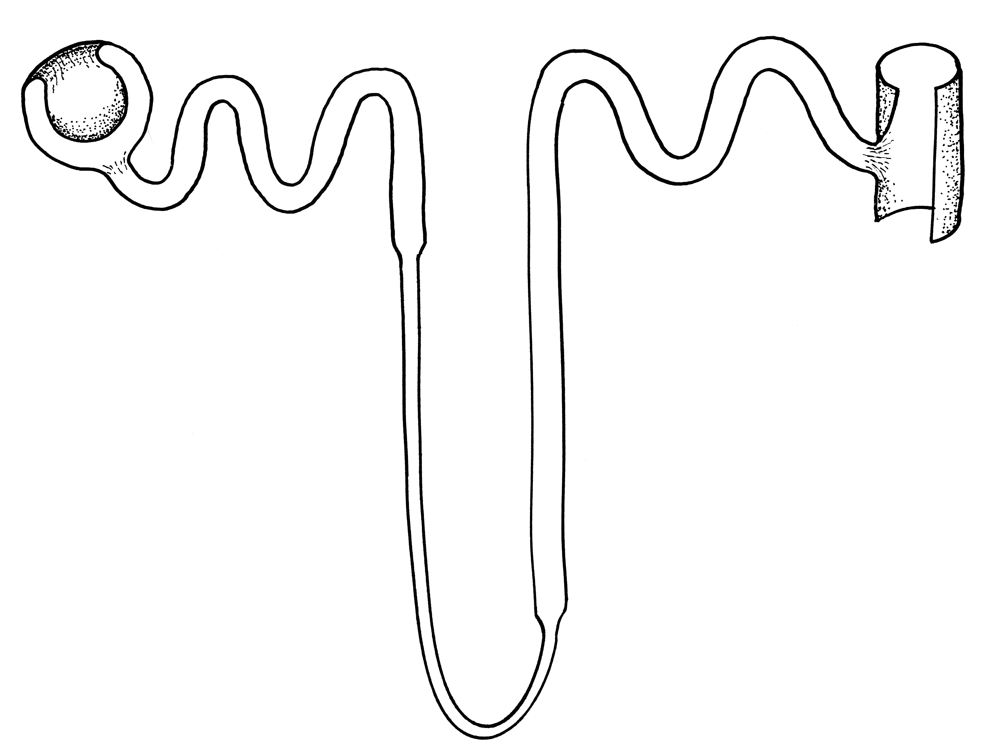
ADH increases
permeability of tubule
Relatively
dilute
filtrate
Water
leaves
the filtrate
Relatively
concentrated
tissue fluid

Slide 50
Negative feedback loop
Decreased blood volume → reduced blood pressure → increased osmotic pressure
Osmoreceptors in hypothalamus
Stimulus
Receptor
Osmotic pressure maintained or reduced
ADH from posterior pituitary gland
Control
centre
Feedback
Thirst reflex
Drink
Water levels in blood increase
Response
Effector
Water reabsorbed
Increases permeability of DCT and collecting duct

Slide 51
Regulating water intake
At times of strenuous activity water loss can be quite high. Once water is lost from the blood, the plasma becomes more concentrated and therefore a higher osmotic pressure. This causes water to move from the intercellular fluid into the plasma, via osmosis. This makes the intercellular fluid more concentrated and water moves out of the cells. The cells start to shrink from dehydration.
The following outlines how the restoration of water balance occurs in such a situation:

Slide 52
1. As water is lost from the various body fluids, there is a reduction in plasma volume and an increase in osmotic concentration of the extracellular fluid.
2. Osmoreceptors in a thirst centre in the hypothalamus detect the rising osmotic concentration of the blood. Other stimuli such as a dry mouth are also involved.
3. Nerve impulses to cerebral cortex
4. The conscious feeling of thirst stimulates the person to drink.
5. Effector/skeletal muscles carry out response – drinking action
5. The fluid consumed is absorbed into the plasma from the alimentary canal.

Slide 53
6. As the blood circulates through the body, it enables the intercellular fluid and intracellular fluid to return to the proper osmotic concentration. Figure 8.17 shows how water moves between the various parts of the body.
7. After drinking, the thirst centre is no longer stimulated and the desire to take in water ceases. This is another negative feedback loop. In this case it is involved in the regulation of the water content of the body (see Fig. 8.16).

Slide 54
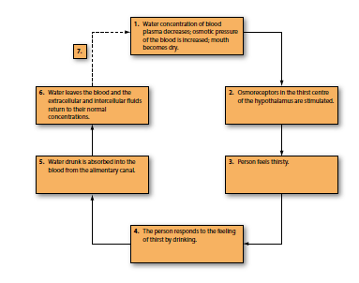

Slide 55
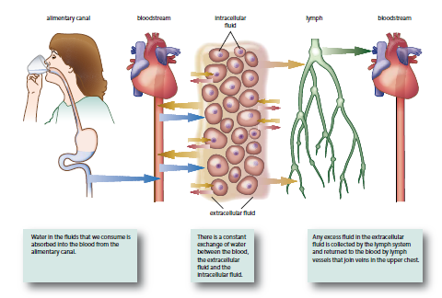

Slide 56
Reabsorption of salt under the influence of aldosterone
Stimulus
Decreased blood volume → reduced blood pressure
Receptor
Baroreceptors in Renal artery sensitive to blood pressure

Slide 57
Transmission
Several chemical messengers ending with release of aldosterone from the adrenal cortex
Effector
Sodium pumps in renal distal convoluted tubule and collecting duct pumps sodium out of filtrate and potassium into filtrate and excreted into urine.
Response
Sodium reabsorbed into interstitial fluid and bloodstream increase ion concentration in interstitial fluid and in blood stream (creates osmotic gradient)
Water is reabsorbed along with the Na ions and therefore aldosterone also plays a roll in incr water absorption and therefore incr in blood volume and therefore blood pressure

Slide 58
Low
Na+
concentration
In filtrate and high pos K ions
filtrate
Aldosterone
stimulates sodium pumps
High
Na+
concentration
In
tissue
Fluid and bloodstream.
K pos ions are secreted into filtrate
Na+
Na+
Na+
Na+

Slide 59
Negative feedback loop
Decreased blood volume → reduced blood pressure
Baroreceptors in Renal artery
Stimulus
Receptor
End-product is aldosterone from adrenal cortex
Creates osmotic gradient and water follows which will incr blood volume and consequently blood pressure
Control
centre
Feedback
Response
Effector
Sodium reabsorbed into bloodstream and K pos ions secreted into filtrate
Sodium pumps in renal tubule

Slide 60
Too much and too little
Dehydration – occurs when water loss exceeds water intake. Symptoms of dehydration include: severe thirst, low blood pressure, dizziness and headache. These symptoms become noticeable when a person has lost about 2% of water.
Water intoxication – occurs when there is too much water in the body. This may be caused by the person losing water and salts through sweating, but only replacing the loss with plain water. Symptoms include light-headedness, headache, vomiting and then collapse.

